Slide 1
Digital Image Processing

Slide 2
Introduction to the course
Grading
Article Reading and Presentation: 15%
Homework: 20%
Exam: 15%
Project: 50%
Total: 100%
Extra Credits: 50%. If the method and experimental results of your project achieve the state of the art, you will earn the extra 50% credits.

Slide 3
推荐用书

Slide 4
什么是数字图像？

Slide 5
数字图像生成
CMOS

Slide 6
数字图像生成
采样和量化

Slide 7
数字图像是指由被称作像素的小块区域组成的二维矩阵。将物理图像行列划分后，每个小块区域称为像素（pixel）。
每个像素包括两个属性：位置和亮度（或色彩）

Slide 9
Representing Digital Images
The representation of an M×N numerical array as

Slide 10
Representing Digital Images
The representation of an M×N numerical array as

Slide 11
Representing Digital Images
Discrete intensity interval [0, L-1], L=2^{k}
The number b of bits required to store a M × N digitized image
b = M × N × k

Slide 12
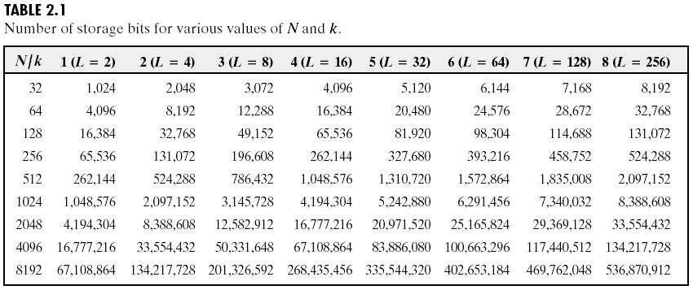
Representing Digital Images

Slide 13

Spatial and Intensity Resolution
Spatial resolution
— A measure of the smallest discernible detail in an image
— stated with line pairs per unit distance, dots (pixels) per unit distance, dots per inch (dpi)
Intensity resolution
— The smallest discernible change in intensity level
— stated with 8 bits, 12 bits, 16 bits, etc.

Slide 14
Spatial and Intensity Resolution
200x200 100x100 50x50 25x25

Slide 15
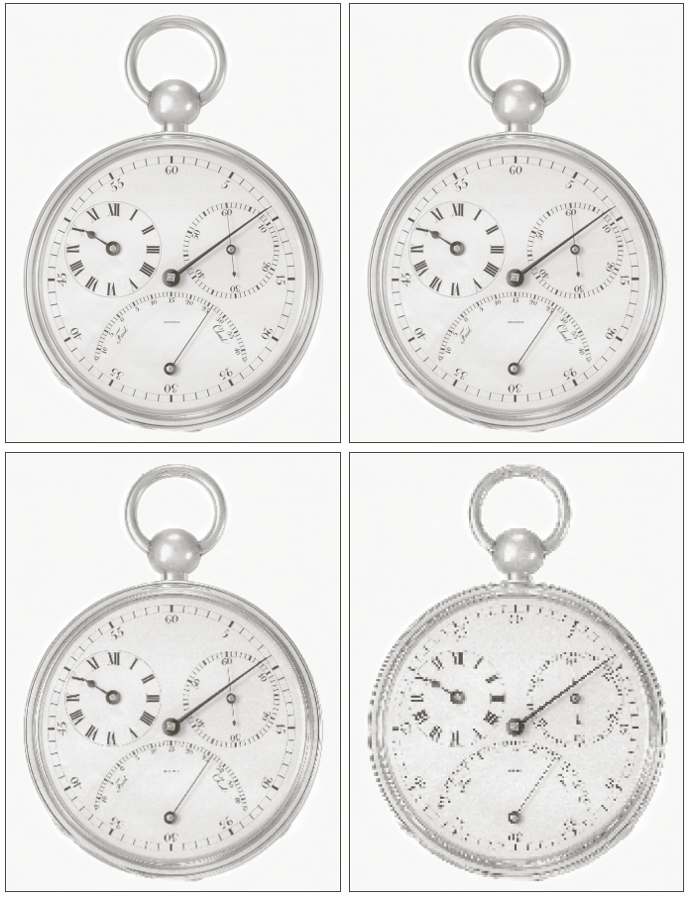
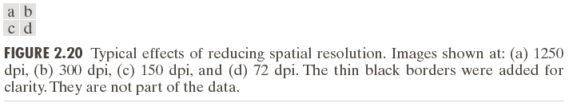
Spatial and Intensity Resolution

Slide 16
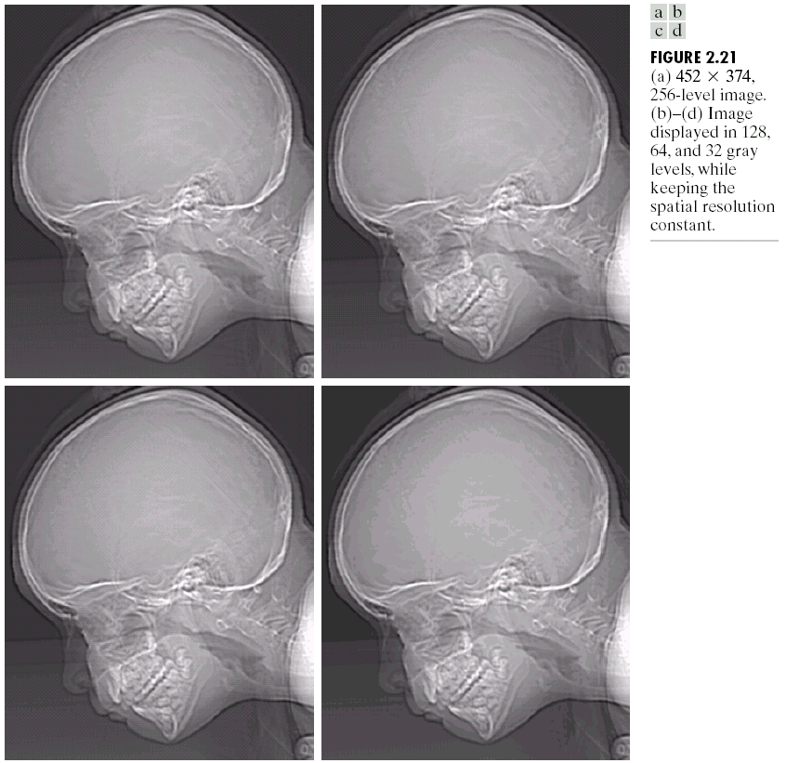
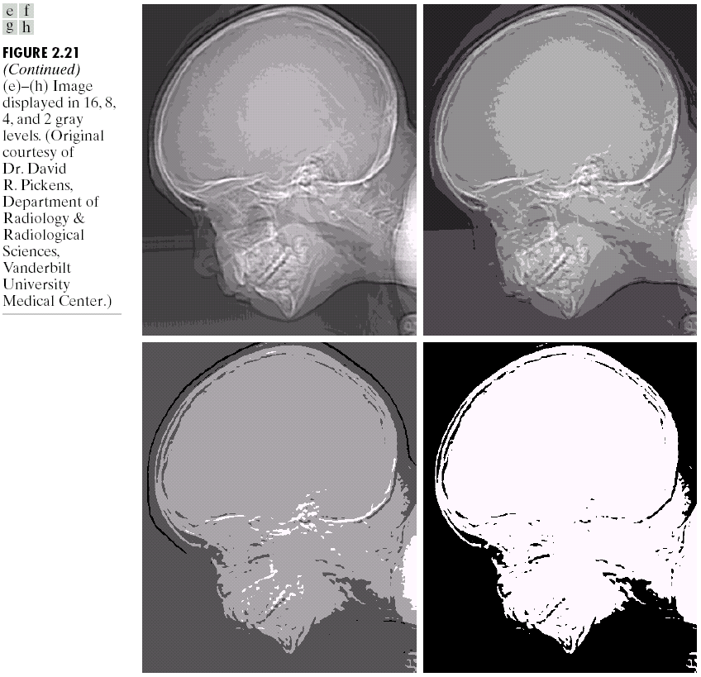
Spatial and Intensity Resolution

Slide 17
为什么需要数字图像处理
Acquire an image
– Correct aperture and color balance
– Reconstruct image from projections
n Prepare for display or printing
– Adjust image size
– Color mapping, gamma-correction, halftoning
n Facilitate picture storage and transmission
– Efficiently store an image in a digital camera
– Send an image from space
n Enhance and restore images
– Touch up personal photos
– Color enhancement for security screening
n Extract information from images
– Read 2-d bar codes
– Character recognition
– Depth estimation
n Many more ... image processing is ubiquitous

Slide 22
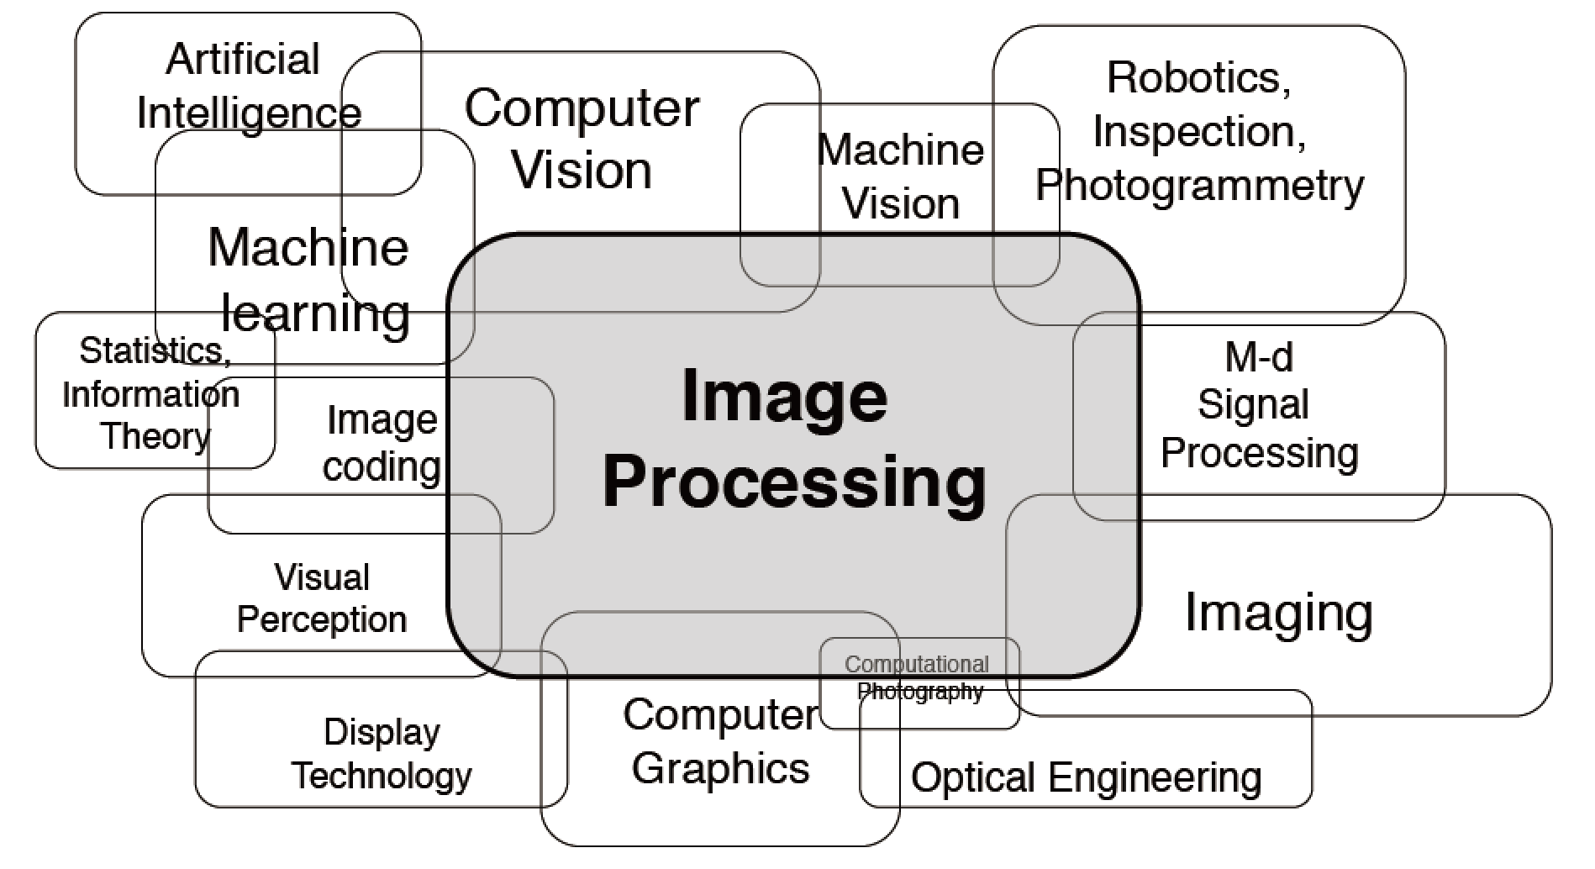

Slide 23
Monochrome image
R[x,y] = G[x,y] = B[x,y]
Red R[x,y] Green G[x,y] Blue B[x,y]

